Slide 1
Wildlife Strikes Team #2
By: Lee Corbin, Noor Drissi, Caleb Neale, Maddie Robinson

Slide 2
Executive Summary
The FAA should investigate why:
Geographical Region
The Northeast region and Great Lakes region of the United States are more susceptible to wildlife strikes
Wildlife
The White-Tailed Deer and Canada Goose have high rates of substantial damage
Time of Day/Year
Bird strikes at dusk and dawn lead to higher damage levels than expected
Most daytime strikes lead to less damage than expected
Aircraft
Airbus aircraft resist damage from wildlife strikes at a higher than expected rate
Safety mechanisms from large aircraft which could be applied in underperforming small aircraft
Executive Summary • Analysis • Final Recommendation • Appendix

Slide 3
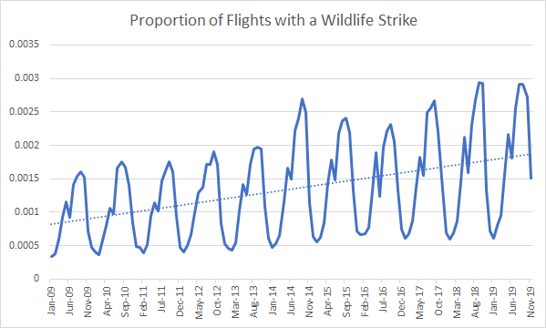
Trend Over Past Decade
There is an increase in proportion of flights with a wildlife strike over the past decade
Cyclical patterns can also be seen in the data (potentially due to wildlife behavior )
Executive Summary • Analysis • Final Recommendation • Appendix

Slide 4
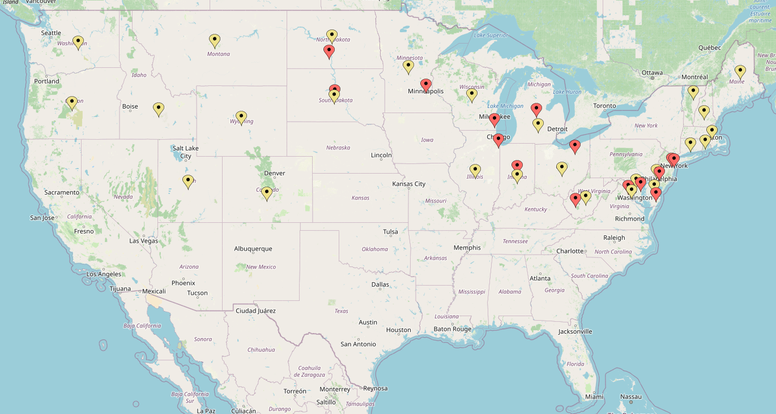


Geographical Location
Key
Most Significant FAA Regions Resulting in Destroyed or Major Damage:
AEA (Eastern)
AGL (Great Lakes)
ANE (New England)
ANM (Northwest Mountain Region)
Destroyed / Substantial
Minor Damage
Most of the most dangerous bird strikes are located along the northern half of the east coast and within the Great Lakes area. The FAA should target these areas within their study as these areas result in the most severe bird strikes in the United States.
Executive Summary • Analysis • Final Recommendation • Appendix
Notes:
A key sector within our analysis was to analyze the major geographical regions in which damage occurs across the united states. After conducting a Chi-squared test to determine these areas, we found that there was significant wildlife impact in the Eastern Region, Great Lakes Region, New England Region, and the Northwest mountain region. The highest severity of damage resulted in the northern half of the east coast and in the great lakes area, the faa should target these areas in their study.

Slide 5
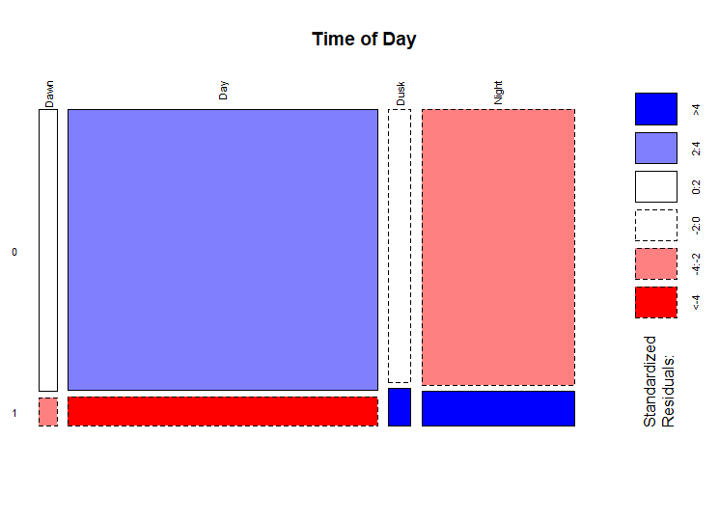
Time of Day
Key:
Red = lower than expected
Dark red = residual < -4
Blue = higher than expected
Dark blue = residual > -4
No damage
While day might have the highest number of strikes (in absolute terms), it seems like the highest proportion of damaging strikes and error in judgement show up in low visibility (dusk and night).
Damage
Executive Summary • Analysis • Final Recommendation • Appendix

Slide 6
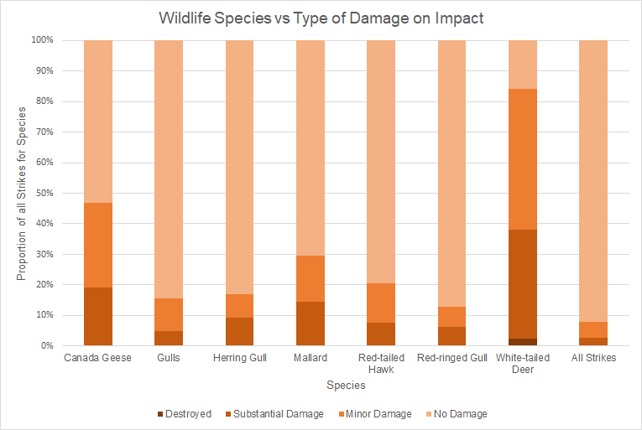
Wildlife Species
The FAA should target White-tailed Deer and Canada Geese, as they are by far the most likely wildlife to cause damage when struck, and gulls, which do not have the same rate of substantial damage but have far more strikes overall.
Total Reported Strikes by Wildlife Species
Canada Goose | Gulls | Herring Gull | Mallard | Red-tailed Hawk | Ring-Billed Gull | White-tailed Deer
1655 | 5884 | 616 | 649 | 1595 | 802 | 1087
Executive Summary • Analysis • Final Recommendation • Appendix
Notes:
White tailed deer are by far the most proportionally damaging wildlife strike, and are responsible for the most instances of destruction and severe damage of any species.
The most proportionally most destructive bird strikes come from Canada Geese and Mallards.
Wildlife species that most often cause substantial damage of those that make up at least .1% of all strikes are
Canada Geese
White-tailed Deer
Mallards
Red-tailed Hawk
Various Species of Gull

Slide 7
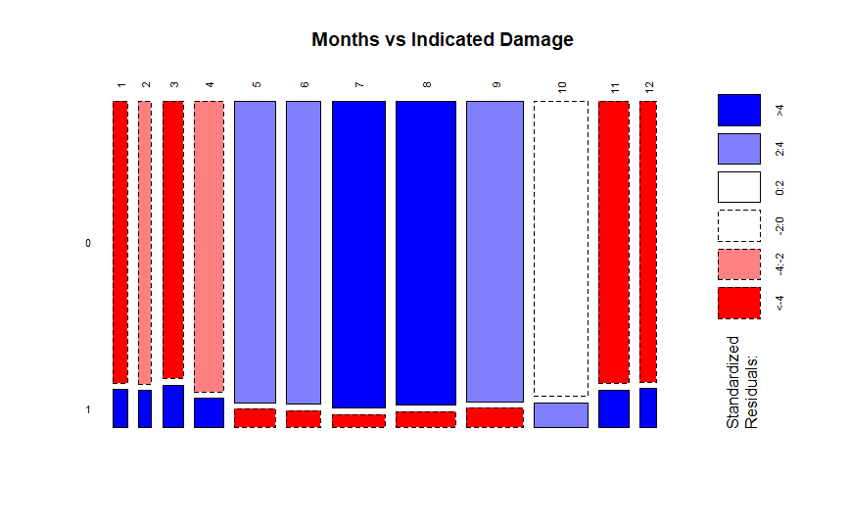
Time of Year
Majority of strikes in late Summer (August/September), but lowest proportion of strikes with reported damage
The Winter, despite having the least reported strikes overall, has the highest proportion of strikes with reported damage
No damage
Due to the apparent diversity in the number of wildlife strikes and rate of damaging strikes throughout the year, we recommend the FAA collects data in multiple seasons to account for the heterogeneous nature of the data
Damage
Executive Summary • Analysis • Final Recommendation • Appendix

Slide 8
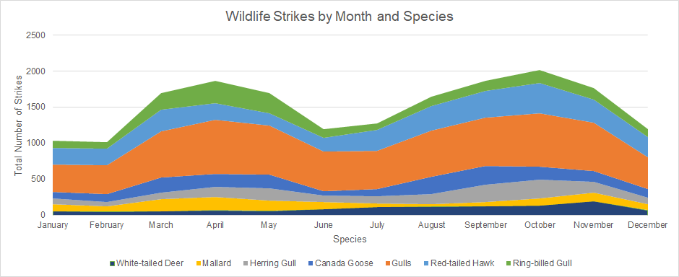
Time of Year vs Species
Of the most damaging wildlife species (as shown in previous slide), there is a clear bimodal pattern to the data with peaks in Spring and Autumn
All wildlife strikes as a very different distribution, a single mode in late summer/early fall
The location of the two peaks suggests that migration habits may influence bird strikes, which we recommend the FAA do further research on.
Executive Summary • Analysis • Final Recommendation • Appendix

Slide 9
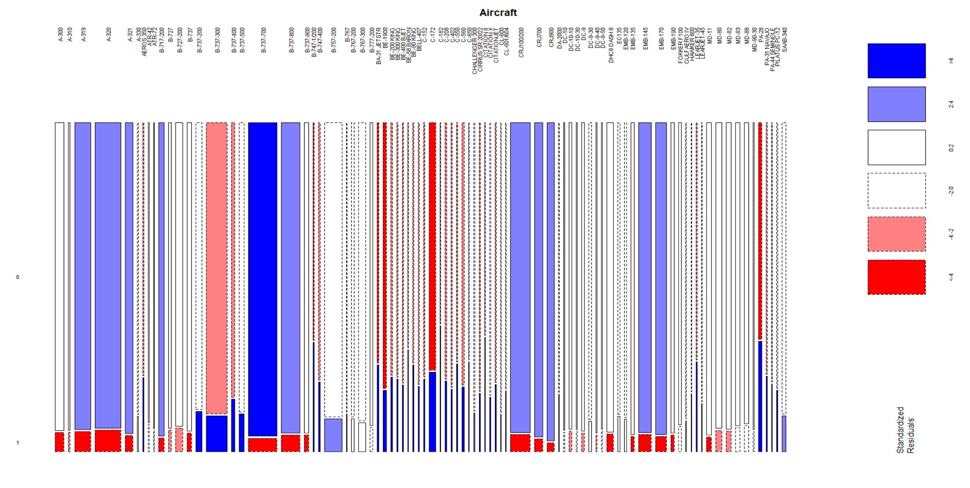
Aircraft Mosaic Chart
No damage
Damage
Executive Summary • Analysis • Final Recommendation • Appendix
Notes:
Aircraft that accounted for less than 0.1% of wildlife strikes were excluded from analysis.
Most aircraft with a large count of birdstrike have statistically lower than expected counts of damage indicated, with the notable exception of the Boeing 737-300.
Across all their models in this dataset, Airbus aircraft have lower than expected incidence of damage from wildlife strikes.
Every Beechcraft model in this dataset has higher than expected incidence of damage indicated.
Every Cessna model in this dataset has higher than expected incidence of damage indicated.
With the notable exception of B-737-300 and B-737-400, all medium/large, turbofan engined airplanes have at or above expected counts of damage free bird strikes
All smaller models, regardless of engine type have at or below expected counts of damage free bird strikes, with no notable exceptions.

Slide 10
Aircraft Mosaic Chart (Airbus)
No damage
Damage
Executive Summary • Analysis • Final Recommendation • Appendix
Notes:
Most aircraft with a large count of birdstrike have statistically lower than expected counts of damage indicated, with the notable exception of the Boeing 737-300.
Across all their models in this dataset, Airbus aircraft have lower than expected incidence of damage from wildlife strikes.
Every Beechcraft model in this dataset has higher than expected incidence of damage indicated.
Every Cessna model in this dataset has higher than expected incidence of damage indicated.
With the notable exception of B-737-300 and B-737-400, all medium/large, turbofan engined airplanes have at or above expected counts of damage free bird strikes
All smaller models, regardless of engine type have at or below expected counts of damage free bird strikes, with no notable exceptions.

Slide 11
Aircraft Mosaic Chart (Boeing)
No damage
Damage
Executive Summary • Analysis • Final Recommendation • Appendix
Notes:
Most aircraft with a large count of birdstrike have statistically lower than expected counts of damage indicated, with the notable exception of the Boeing 737-300.
Across all their models in this dataset, Airbus aircraft have lower than expected incidence of damage from wildlife strikes.
Every Beechcraft model in this dataset has higher than expected incidence of damage indicated.
Every Cessna model in this dataset has higher than expected incidence of damage indicated.
With the notable exception of B-737-300 and B-737-400, all medium/large, turbofan engined airplanes have at or above expected counts of damage free bird strikes
All smaller models, regardless of engine type have at or below expected counts of damage free bird strikes, with no notable exceptions.

Slide 12
Aircraft Mosaic Chart (Beechcraft)
No damage
Damage
Executive Summary • Analysis • Final Recommendation • Appendix
Notes:
Most aircraft with a large count of birdstrike have statistically lower than expected counts of damage indicated, with the notable exception of the Boeing 737-300.
Across all their models in this dataset, Airbus aircraft have lower than expected incidence of damage from wildlife strikes.
Every Beechcraft model in this dataset has higher than expected incidence of damage indicated.
Every Cessna model in this dataset has higher than expected incidence of damage indicated.
With the notable exception of B-737-300 and B-737-400, all medium/large, turbofan engined airplanes have at or above expected counts of damage free bird strikes
All smaller models, regardless of engine type have at or below expected counts of damage free bird strikes, with no notable exceptions.

Slide 13
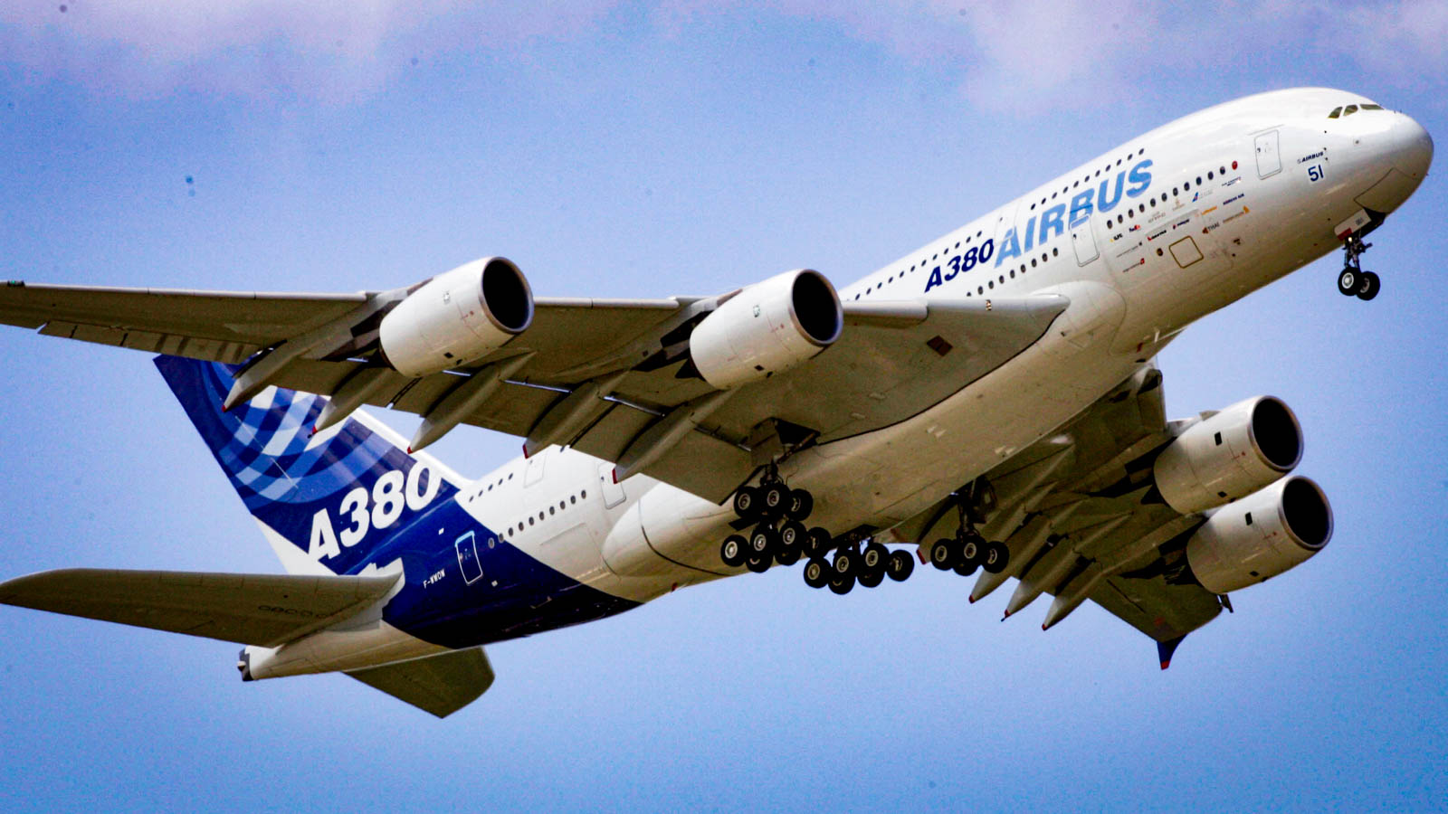
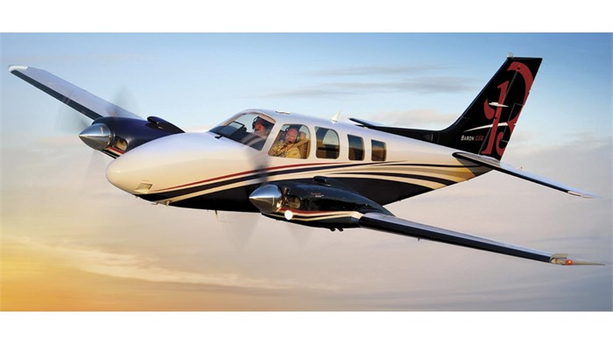
Aircraft
The FAA should study differences in performance between Airbus and Boeing aircraft to isolate factors influencing differences in damage resistance.
Specific focus should be placed on Boeing 737-300 and 737-400 models for their higher than expected counts of damaging wildlife strikes.
Ways to mitigate the outsized effect of wildlife strikes on smaller aircraft should also be investigated.
Airbus Aircraft
Beechcraft Aircraft
Executive Summary • Analysis • Final Recommendation • Appendix

Slide 14
Final Recommendation
The FAA should investigate why:
Geographical Region
The Northeast region and Great Lakes region of the United States are more susceptible to wildlife strikes
These areas show the highest counts of aircrafts destroyed and should be highlighted as a subject matter of interest
Wildlife
The White-Tailed Deer and Canada Goose have high rates of substantial damage
Species behavior, such as migration, impacts frequency of strikes
Time of Day/Year
Bird strikes at dusk and dawn are associated with higher damage levels
Daytime strikes are associated with less damage
Studies need to collect data through the year, as impact rates and severity change dramatically in different seasons
Aircraft
Airbus aircraft resist damage from wildlife strikes at a higher than expected rate
Safety mechanisms from large aircraft which could be applied in underperforming small aircraft
Executive Summary • Analysis • Final Recommendation • Appendix
Notes:
Our final recommendation is for the FAA to investigate the Northeast and great lakes region since these areas have the greatest counts of destroyed aircrafts, The Faa should investigate white tailed deer and canadian geese since both of these species result in high frequency of impacts. The time of day and time of year is important for the FAA to investigate since many severe willife strikes occur at dusk and dawn. Lastly the FAA should investigate certain aircrafts since some aircrafts are disproportionately likely to result in severe wildlife strikes.

Slide 15
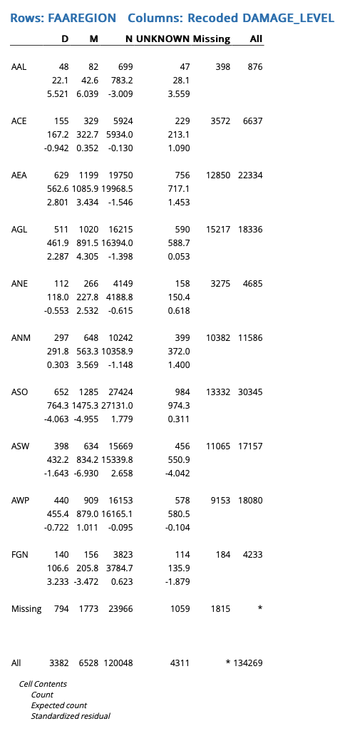
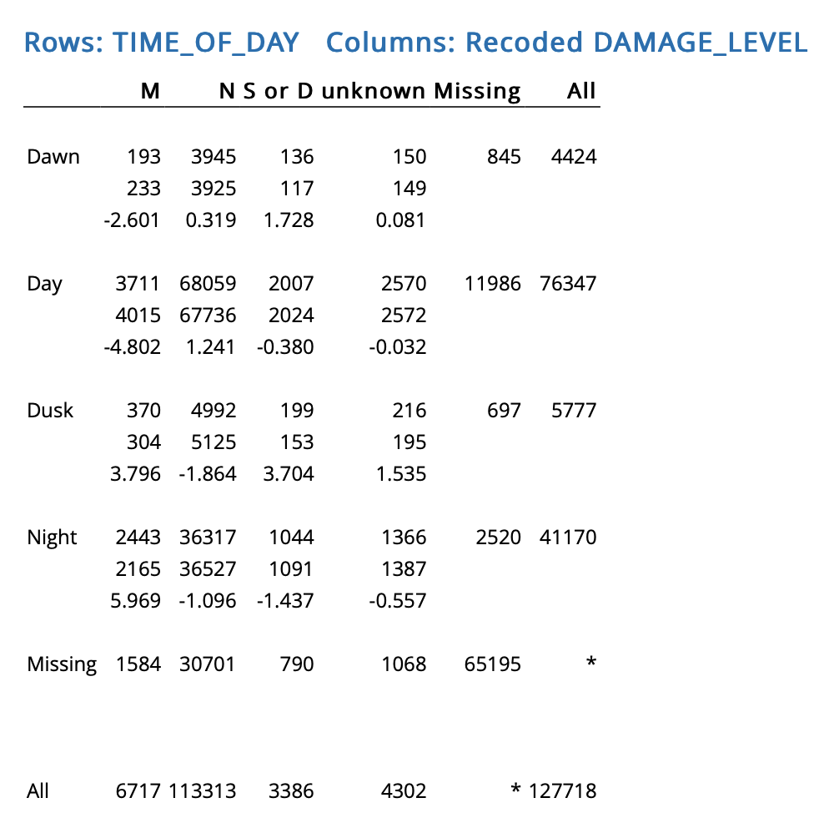
Appendix A
Chi-Squared Tests
Chi-Square test of month vs damage level
Chi-Square test of bird species vs month
Chi-square test of bird species vs damage level
Count
Expected Count
Standardized Residuals
Executive Summary • Analysis • Final Recommendation • Appendix

Slide 16
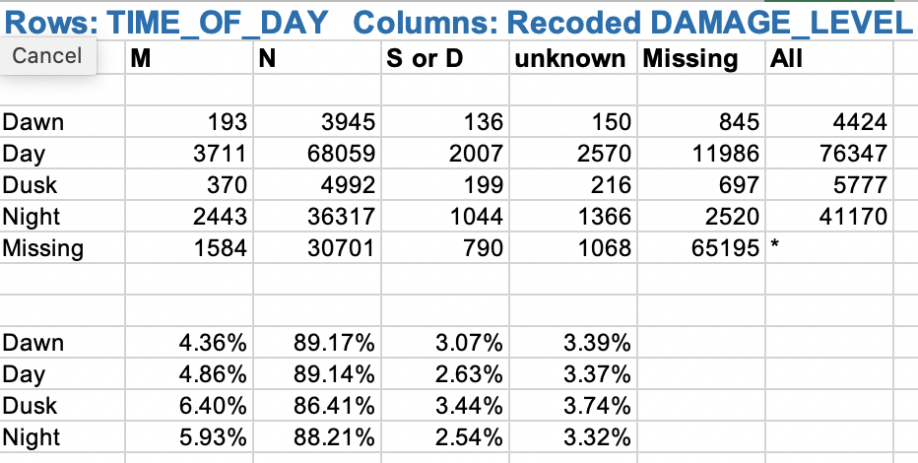
Appendix B
Absolute Values and Proportions of Time of Day vs. Damage Level
Executive Summary • Analysis • Final Recommendation • Appendix

Slide 17
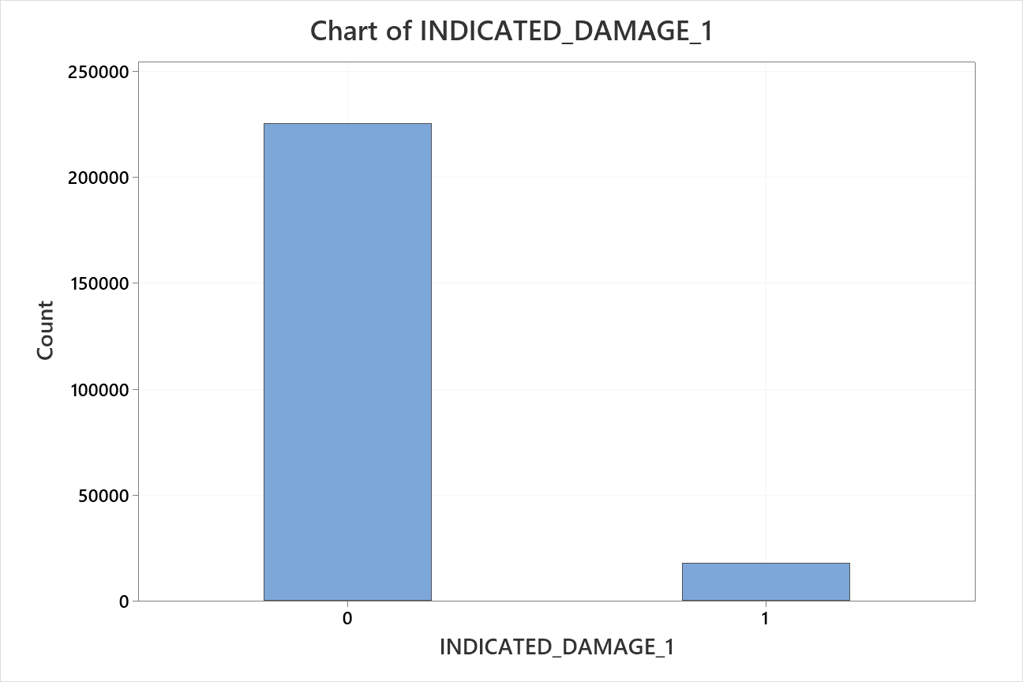
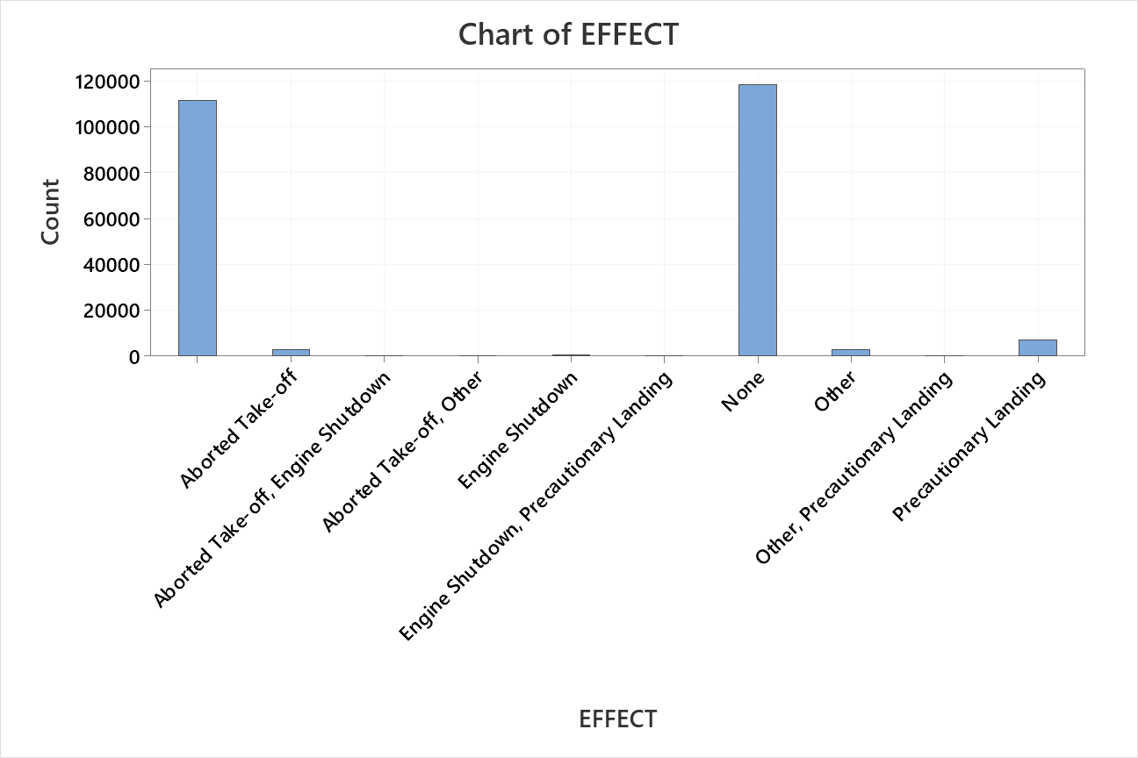
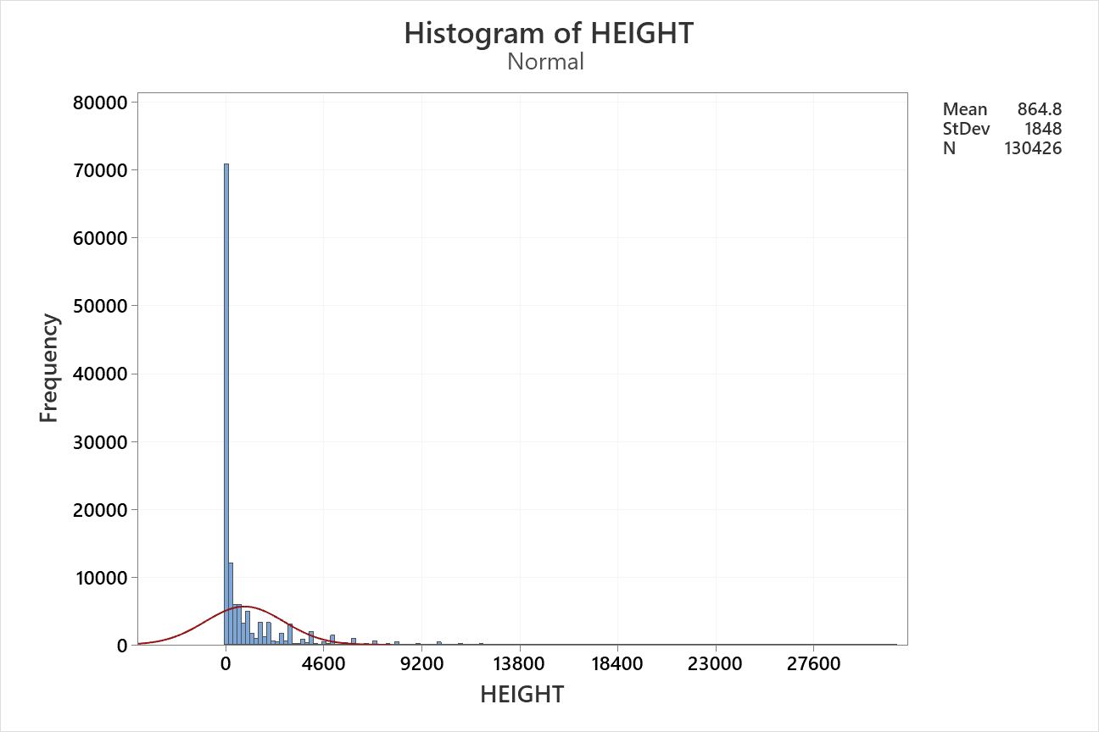
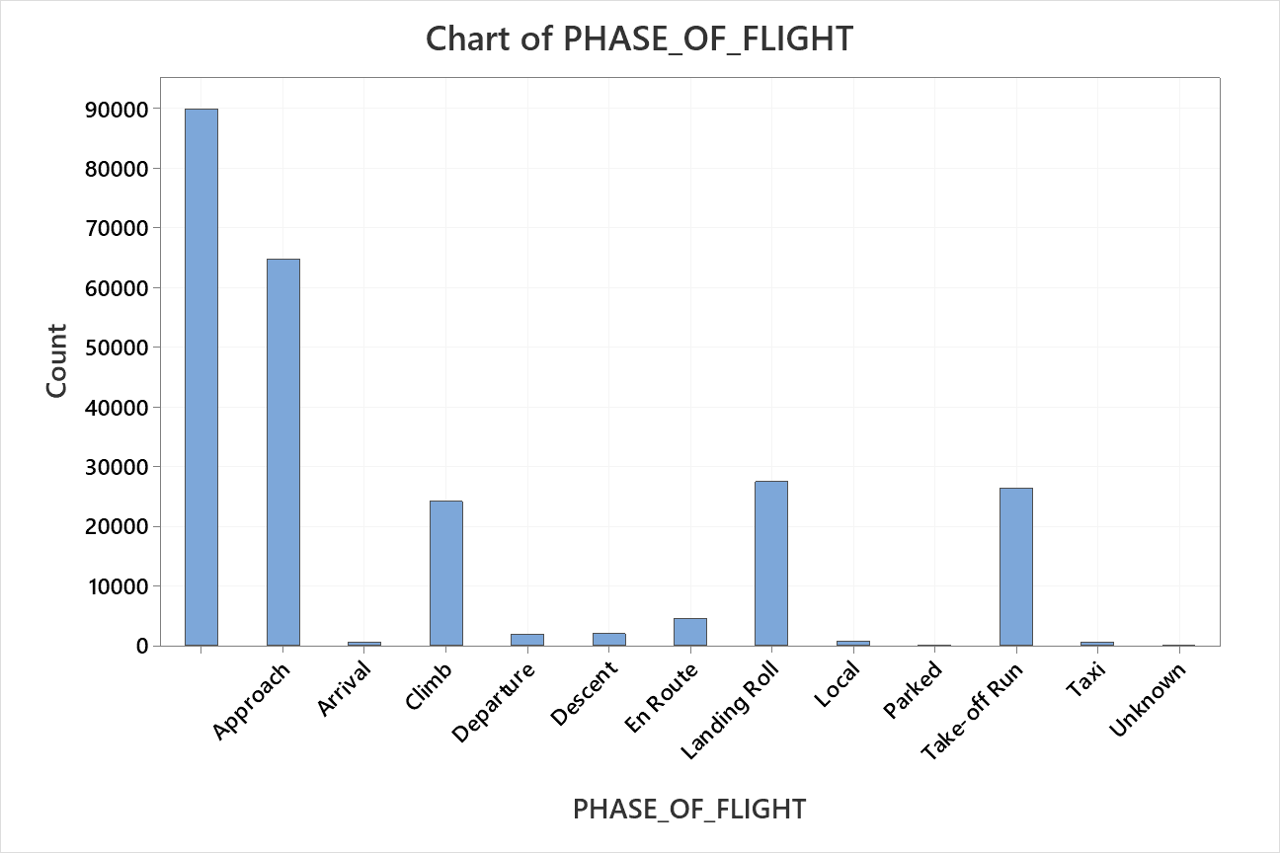
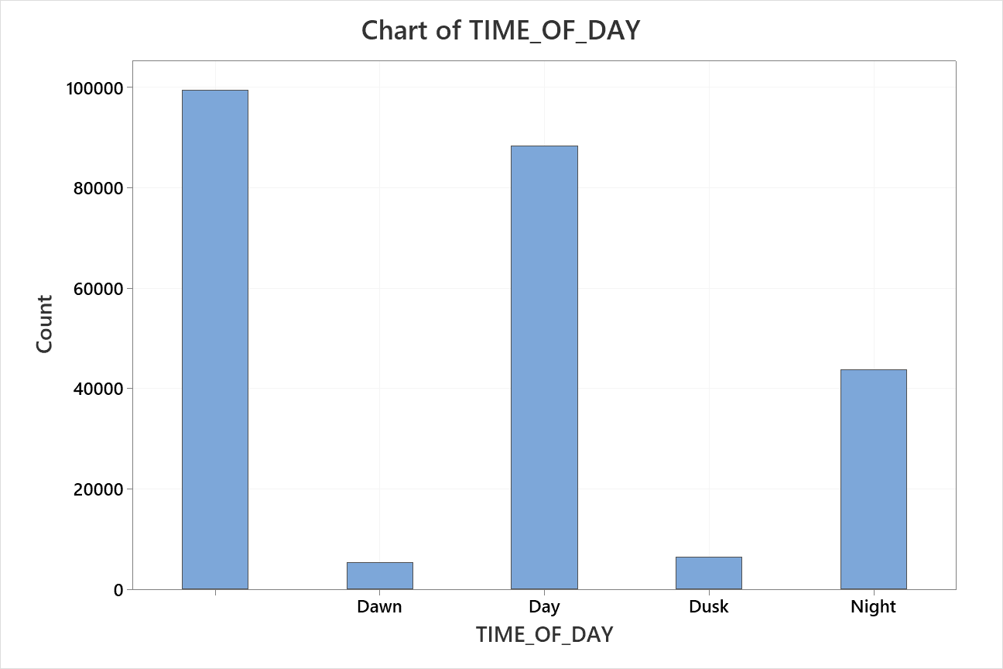
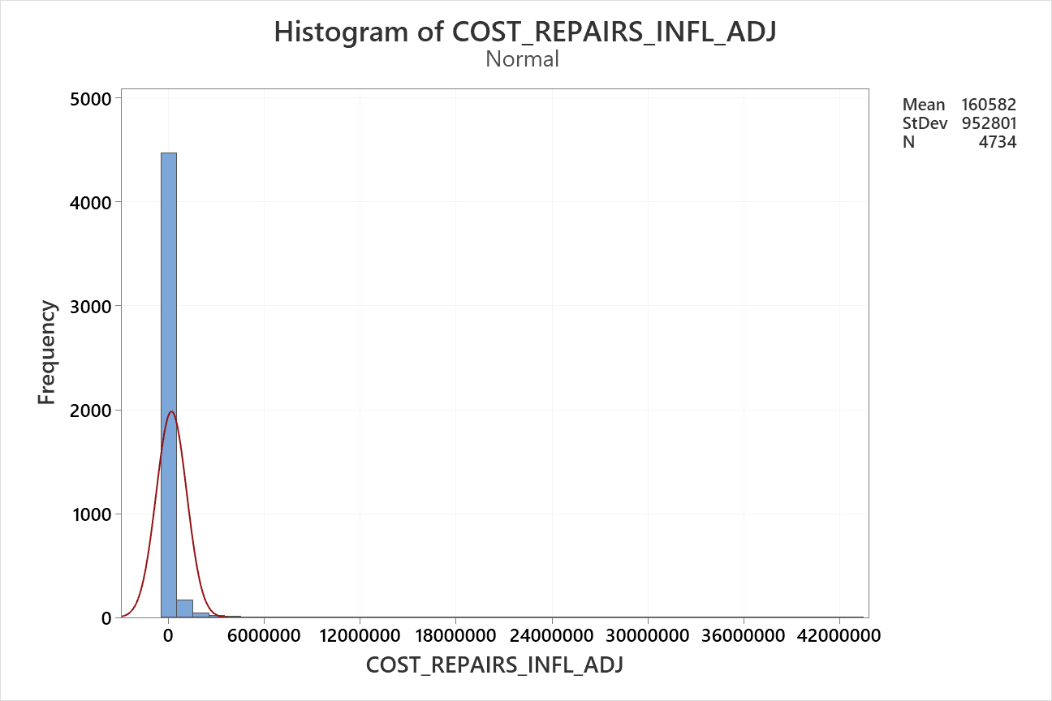
Data Walkthrough
Executive Summary • Analysis • Final Recommendation • Appendix

